Slide 1
Chapter 2 figures

Slide 2
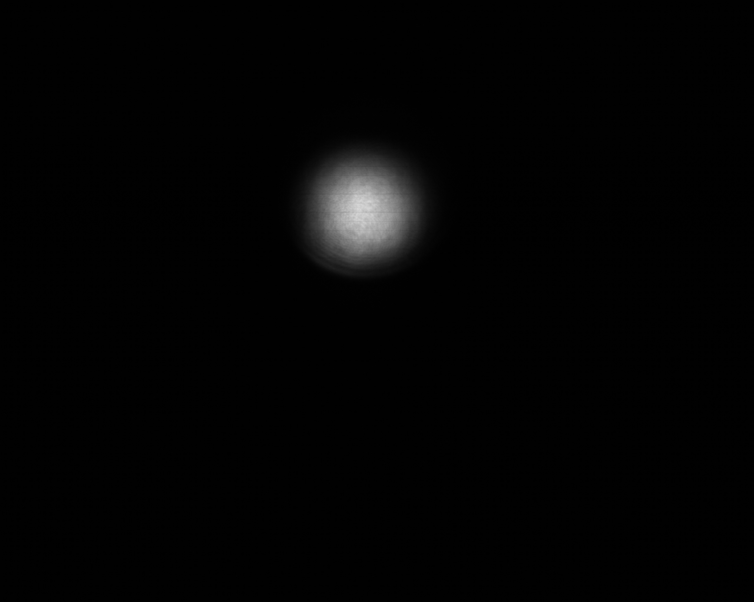
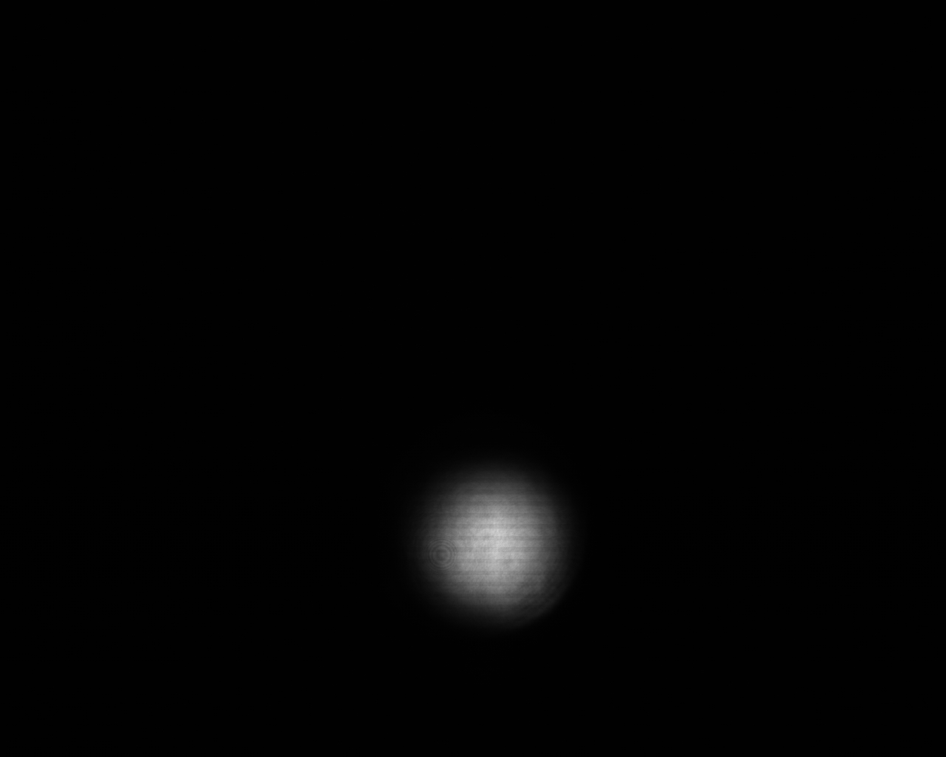
GuideStar Geometry
M0: Dietrich’s motorized mirror
C0: Dietrich’s camera
M1,M2: GuideStar II motorized mirrors
C1,C2: GuideStar II cameras
W: window
SF
C0
M2
W
C1
M0
M1
Ext. Comp.
C2
Cam1
OPA
Cam2

Slide 3
SF
C0
M2
W
C1
M0
M1
Ext. Comp.
C2
Cam1
OPA
Cam2

Slide 4
P
P
1300 iP
G
D65B
WSU501
400 iP
DP₁
P
700 iP
M
DP groove
P
1300 iP
P
T
D65B
WA251
T400i
DP₂
P
400 iP
S
DP groove

Slide 5

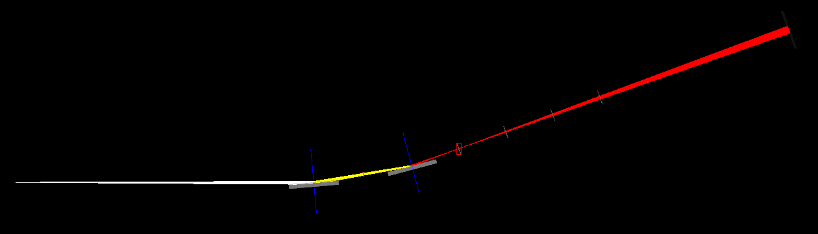
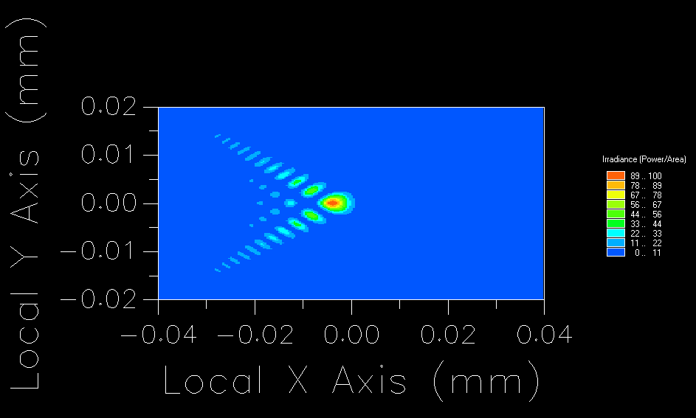
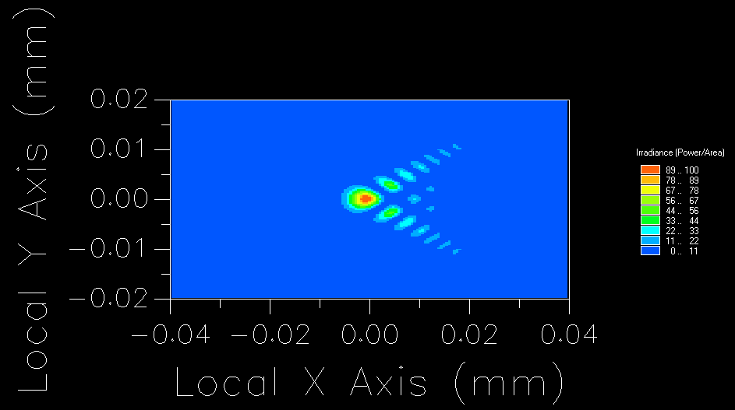
Single Toroid Mirror (TM) Configurations (M=2 or 3)
TM1: $r=150cm$, $r’=50cm$
TM1: $r=150cm$, $r’=75cm$
l₂=50 cm
l₁=150 cm
75cm
focus
150cm
source
TM
TM
FM
Intensity at focus
f-f configuration

Slide 6
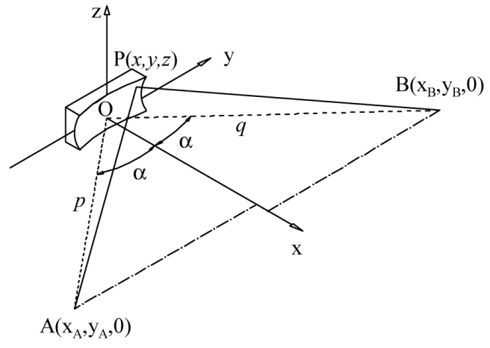




$$l_{2}$$
$$\frac{π}{2}−α$$
$$\frac{π}{2}−α$$
$$l_{1}$$

Slide 7




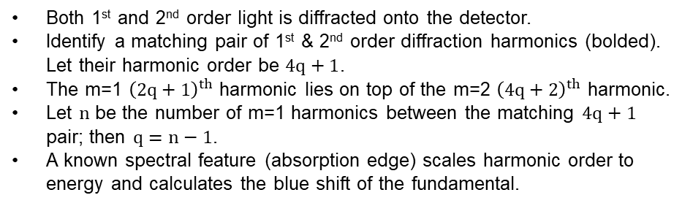





$$4q+1=\left(2q+1\right)+2\left(n−1\right)$$
$$q=n−1$$
$$4q+2 \& 2q+1$$
m=1, m=2
$$2q+5$$
$$4q+1$$
$$2q+3$$
$$…$$
$$4q+1$$
19
21
23
25
27
29
31
9
11
13
15
17
19
21
23
Divergence
$$n=6$$
Energy
Both 1st and 2nd order light is diffracted onto the detector.
Identify a matching pair of 1st & 2nd order diffraction harmonics (bolded). Let their harmonic order be $4q+1$.
The m=1 ${\left(2q+1\right)}^{th}$ harmonic lies on top of the m=2 ${\left(4q+2\right)}^{th}$ harmonic.
Let $n$ be the number of m=1 harmonics between the matching $4q+1$ pair; then $q=n−1$.
A known spectral feature (absorption edge) scales harmonic order to energy and calculates the blue shift of the fundamental.

Slide 8
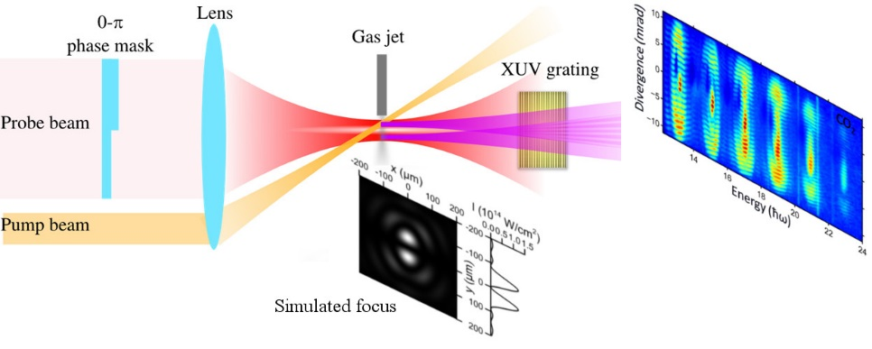
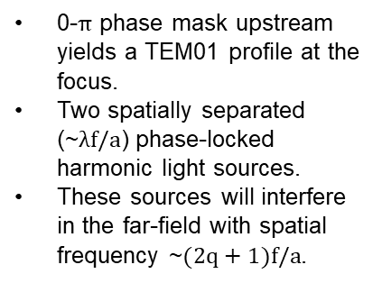
0-$π$ phase mask upstream yields a TEM01 profile at the focus.
Two spatially separated (~$λf/a$) phase-locked harmonic light sources.
These sources will interfere in the far-field with spatial frequency ~$(2q+1)f/a$.
Notes:
Erice 2017 poster

Slide 9
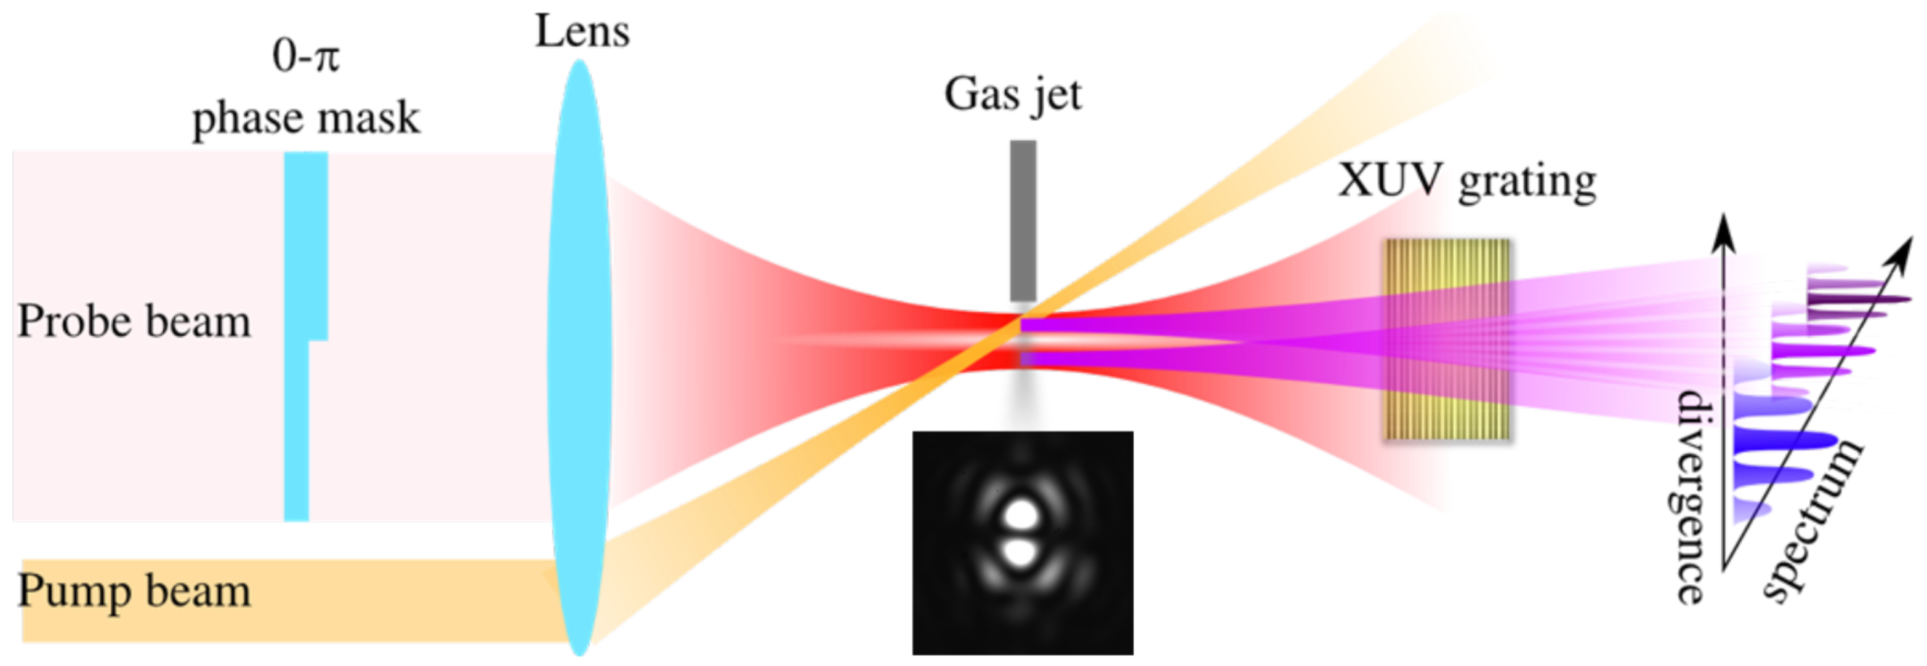
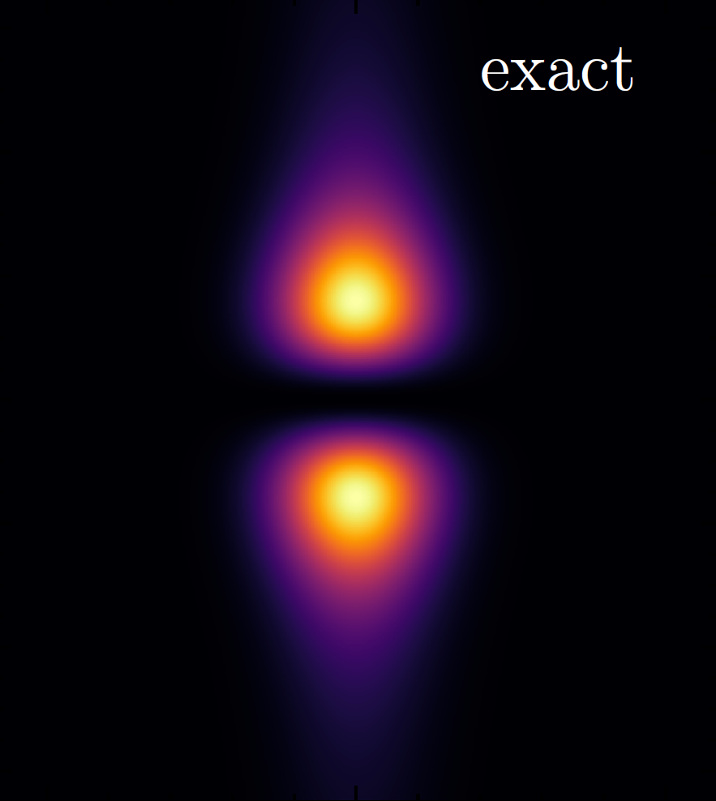

Slide 10
